Slide 1

A Clear Future For Libbey Inc.
Harnessing direct selling to achieve sustainable growth in Indonesia
Presented by:
Trip Burke, Charlie Deng, Priya Khanna, Catherine Miller, Wade Oakley, and Bill Su

Slide 2
Libbey Inc. has an excellent opportunity to expand its business in Indonesia by harnessing direct selling channels and positioning its products as both globally respected and aspirational.
Goals:
10%
Direct Selling Force
200M IDR
of over 1,500
Revenue Per Salesperson
Market Share

Slide 3
Company Overview
Market Analysis
Entry Strategy
Financial Projection

Slide 4
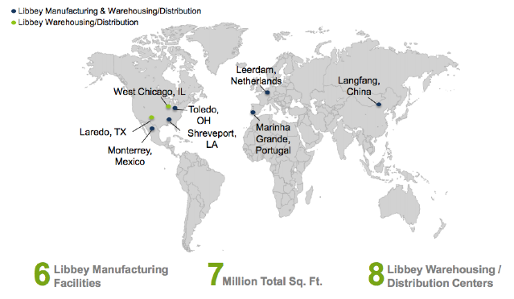
Libbey Glass is a company that exemplifies variety, internationality, flexibility, and success
Variety
Internationality
Flexibility
Success
Six Extensive Brands
Selling in Over 100 Countries
Three Distinct Channels
Financial Capacity to Expand

Slide 5



Of Libbey Inc.’s product portfolio, Libbey Glassware, Syracuse China, and World Tableware are the most adaptable
Brand
Products
Target Segment
Glass tableware, including wine glass, jars, and other household glassware
Households or restaurants seeking high-quality glass products
Ceramic tableware such as plates and bowls
Households seeking high performance ceramic tableware
Comprehensive tableware products of all materials
Restaurants seeking comprehensive tableware solutions

Slide 6




Indonesia’s cultural environment and positive economic prospects will drive Libbey Inc.’s success
Cultural
Desire to Appear Affluent
Importance of Tea in Culture
Prevalence of Gifting
Economic
6th Largest Economy by 2020
Rising Disposable Income
Rapidly Growing Domestic Market

Slide 7



Libbey will make key process adaptations to penetrate the Indonesian market
Stage 1
Setup
Logistics
Marketing
Manufacturing in China
Outsource warehousing and distribution to DHL
Cost savings through existing manufacturing processes and cross-decking
Taper off retail presence
Enter JV
Market Research
Direct Selling
Office in Jakarta
JV integrated processes
Focus on the top 40% of the market
Penetrate social networks
Launch eCommerce

Slide 8
Libbey will push eCommerce as its brand grows
Stage 2
Build trust through social networks
Push customers to eCommerce
Localized, “Own the Moment” messaging
Improved accessibility, broader geographic reach, increased sales
Strengthened Libbey Brand
Timing is
Key!

Slide 9
Libbey can further adapt and aggregate across channels and countries in the long run
Stage 3
Success with direct selling in Indonesia
Open showcase stores in urban areas
Expand to different channels
New product lines
Expand into similar new markets

Slide 10
Entering a JV with leading direct selling firm will enable Libbey to successfully enter and navigate the Indonesian market
- $60/40 profit split
- Integrated goals and operating processes
- Shared local office
- Better understanding of market
- Expanded R&D Capabilities
- Improved future prospects for both firms
ZHULIAN
Sells in Malaysia, Indonesia, Singapore, & Thailand
ELKEN
QNET
Experienced seller of luxury products
 | ZHULIAN | ELKEN | QNET
Ideal Geographic Scope | ★★★ | ★ | ★★
Experience (specifically in Indonesia) | ★ | ★★ | ★★★
Willingness to Accept Incentives | ★★★ | ★★ | ★
Lack of Competing Products | ★★★ | ★★ | ★
Likely Interest in Libbey | ★★★ | ★★ | ★
Notes:
perspective on emerging market trends and technologies based on their field experience.
define goals and integrate operating processes for the duration of this project. This will result in efficient use of shared resources and expanded R&D capabilities.
40% of Libbey Indonesia profits will be given to the direct selling firm to ensure alignment of incentives and effort
Libbey will set up an office in Jakarta, Indonesia.
Two expatriates with prior international expansion experience selected by Libbey Corporate will be sent to the Jakarta office, including an expansion manager and a rising star as the head of the Indonesia office.
Libbey will control product orders, distribution, and logistics (aided by its relationship with DHL), and overall strategic management of the corporation including branding and product positioning.
The direct selling firm will control the human resource function (salespeople), advertising, and market research.
In stage 1 of this strategy, the firm will employ unique customer feedback collection and analysis to create an agile marketing and selling strategy
The JV contract will be reevaluated every 2 years, according to progress benchmarks.

Slide 11
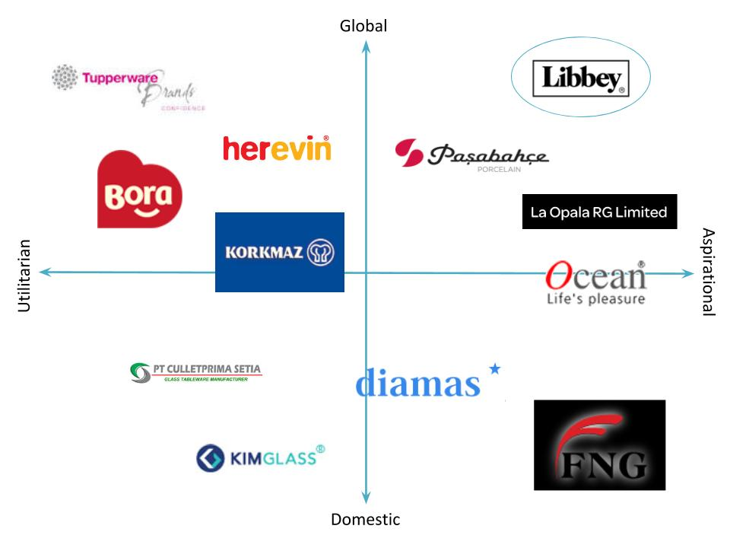
Appendix: Libbey Inc. should position itself as a global brand that offers aspirational and high-quality products

Slide 12
Libbey Inc.’s intended direct selling strategy and local value proposition will drive our marketing decisions
Libbey Inc. offers homeware products to the Indonesian market that are high-quality, globally trusted, and can serve as decorative pieces in the home.
Place
Product
Promotion
Price

Slide 13
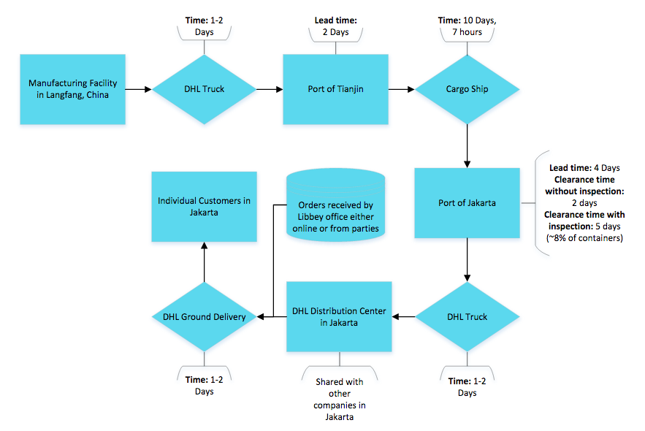
Collaboration with DHL and local partners will foster efficient transportation logistics and distribution
Best case supply line length: 17 days
Worst case supply line length: 23 days
Fixed time Constraints
Biggest Risk: Alleviated by creating local relationships
DHL will help us monitor demand and determine appropriate inventory levels

Slide 14
Entry is projected to be profitable by Year 3
Cost Drivers
Commission to direct sales representatives
Expats and local employees
Revenue Drivers
Size of sales force
Average sales per representative
Rent expense
Launch parties in Years 1 and 2
E-Commerce platform
Financial Highlights
Revenue accrual begins in Year 1 as launch parties attract sales reps
Profitability is achieved in Year 3 as sales force and E-Commerce platform grow
Metrics are tracked to regularly re-evaluate project

Slide 15
Considering best, base, and worst case scenarios, NPV of entry is $16 million
Case | Probability | NPV | Expected Value
Worst | 10% | -$3,713 | -$371
Base | 70% | $13,356 | $9,349
Best | 20% | $35,844 | $7,169
Sum |  |  | $16,147
*Dollar values in thousands
Libbey current market capitalization | $868,390,000
NPV of project | $16,147,000
60% share to Libbey in JV profit sharing | $9,688,200
Contribution to Libbey's Value as % | 1.12%
In Perspective:

Slide 16
Libbey Inc. has an excellent opportunity to expand its business in Indonesia by harnessing direct selling channels and positioning its products as both globally respected and aspirational.
Goals:
10%
Direct Selling Force
200M IDR
of over 1,500
Revenue Per Salesperson
Market Share

Slide 17
Appendix: Revenue and Cost Models
Revenue Model: Direct Selling and eCommerce
*Sales in IDR (millions), 1 million IDR = 77 USD (as of 4/20/15)
Year | Libbey Sales Force | Sales Per Rep | Direct Sales | eCommerce | Total Sales
1 | 158 | 153 | 24,217 | 0 | 24,217
2 | 249 | 161 | 40,119 | 0 | 40,119
3 | 393 | 169 | 66,462 | 6,646 | 73,108
4 | 620 | 178 | 110,103 | 7,975 | 118,079
5 | 978 | 187 | 182,401 | 9,571 | 191,972
6 | 1543 | 196 | 302,173 | 11,485 | 313,657
Assumptions:
-Ideal sales rep has 3 parties per month, with 6.46 million IDR in sales per party, so 232 million IDR in sales per year
-Starting at 66% sales capacity = 153 million IDR per year
-Sales rep growth is modeled after Tupperware sales force growth, starting with a much lower number of sellers (158 in year 1), see graphs
-eCommerce starts in Year 3 as 10% of direct sales and grows at 20% per year
Cost Breakdown for Year 1 |  |  |  | *In millions of IDR
Expats |  | 2 |  | Launch parties (Years 1 and 2)
Salary |  | 1,292 |  | Number of parties |  | 10
Benefits (70% salary) |  | 904 |  | Cost per party |  | 32
Total per expat |  | 2,196 |  | Total Cost |  | 323
Total cost |  | 4,393
 |  |  |  | Rent expense
Local Employees |  |  |  | Cost per square foot per year |  | 0.78
Number |  | 8 |  | Office size (sq. ft.) |  | 1000
Salary |  | 121 |  | Total Cost |  | 776
Benefits (60% salary) |  | 73
Total per employee |  | 193 |  | Marketing expense
Total cost |  | 1,548 |  | Promotions and giveaways |  | 129
 |  |  |  | Total Cost |  | 129
Commission to sales force
30% of sales
Summary of assumptions and yearly changes:
-Expat compensation increases by 4% annually
-Local employee compensation increases by 4% annually
-Rent expense increases by 4% annually
-Launch party expense increases by 4% in Year 2 (end of Launch Parties)
-Marketing expense grows by 2% annually (and most marketing is outsourced to direct selling partner, heavy reliance on word of mouth)
-Commission to sales force is 26% of their sales
-COGS is 64% of sales, includes tariff of 5% on glassware imports
Sources: COMM 3050 slides, MyExpatriate Pay for Indonesia, http://www.cushmanwakefield.com/~/media/global-reports/OSATW%202014%20Publication%20updated.pdf, KPMG Primer on Indonesian Value Added Tax

Slide 18
Appendix: Base case DCF shows NPV of $13 million (IDR 172,509 million)
*Numbers in IDR millions
 | 2016 | 2017 | 2018 | 2019 | 2020 | 2021 | 2022
Revenue from direct selling | 24,217 | 40,119 | 66,462 | 110,103 | 182,401 | 302,173 | 308,216
Revenue from eCommerce |  |  | 6,646 | 7,975 | 9,571 | 11,485 | 11,714
Total Revenue | 24,217 | 40,119 | 73,108 | 118,079 | 191,972 | 313,657 | 319,930
COGS | 15,499 | 25,676 | 46,789 | 75,570 | 122,862 | 200,741 | 204,755
Gross Profit | 8,718 | 14,443 | 26,319 | 42,508 | 69,110 | 112,917 | 115,175
SGA
Commission to sellers | 6,296 | 10,431 | 17,280 | 28,627 | 47,424 | 78,565 | 80,136
Launch parties | 323 | 339 | 0 | 0 | 0 | 0 | 0
Expat compensation | 4,393 | 4,569 | 4,751 | 4,941 | 5,139 | 5,345 | 5,558
Local employee compensation | 1,548 | 1,610 | 1,674 | 1,741 | 1,811 | 1,883 | 1,959
Marketing expense | 129 | 132 | 134 | 137 | 140 | 143 | 146
Rent expense | 776 | 807 | 839 | 873 | 908 | 944 | 982
EBIT | -4,747 | -3,444 | 1,640 | 6,189 | 13,688 | 26,037 | 26,394
Taxes | -1,187 | -861 | -1,638 | 1,547 | 3,422 | 6,509 | 6,599
NOL Tax Asset | 1,187 | 2,048 | 0 | 0 | 0 | 0 | 0
Net Income / FCF | -4,747 | -3,444 | 3,278 | 4,642 | 10,266 | 287,040 | 19,796
WACC | 9.40% | PGR | 2% |  |  | Terminal Value | 267,512
Total NPV (IDR millions) | $172,509
NPV in USD (millions) | $13,352
Assumptions:
-See cost and revenue models for:
-Revenue from direct selling
-Revenue from eCommerce
-Base Year 1 costs
-Sales commission is 26%
-Launch parties run for 2 years
-Expat compensations grows 4% annually
-Marketing expense grows 2% annually
-Rent expense grows 4% annually
-Local employee compensation grows 4% annually
-NOL tax asset from losses can be used in Year 3
-Tax rate is 25%
-WACC = 9.4% (see Appendix)
-Perpetual growth rate = 2% -Entry starts in 2016

Slide 19
Appendix: Best, Base, and Worst Case Scenario Criteria
Scenario Criteria:
Base Case
Beta = 1.03 (industry averages)
WACC = 9.4% (see WACC calculations in Appendix)
eCommerce starts in 2018 at grows at 20% annually
Sales per representative start at $11,880 and grow 5% annually
Start with 158 sales reps in Year 1
Perpetual growth rate = 2%
COGS is 64% of sales
Best Case
Beta = 1.03 (industry averages)
WACC = 9.4% (see WACC calculations in Appendix)
eCommerce starts in 2018 at grows at 30% annually
Sales per representative start at $18,000 and grow 5% annually
Start with 158 sales reps in Year 1
Perpetual growth rate = 2%
COGS declines to 60% of sales
Worst Case
Beta = 1.03 (industry averages)
WACC = 9.4% (see WACC calculations in Appendix)
eCommerce starts in 2018 at grows at 20% annually
Sales per representative start at $6000 and grow 5% annually
Start with 158 sales reps in Year 1
Perpetual growth rate = 1%
COGS rises to 70% of sales

Slide 20
Appendix: Sales Force Growth Estimates and WACC
Tupperware’s sales force growth was used to estimate the Libbey sales force, starting with fewer sales agents at the start:
WACC
Cost of Equity (CAPM)
10-yr yield | 7.41%
Default Spread | 2.2%
Risk Free Rate: | 5.2%
Equity Risk Premium: | 9.1%
Beta | 1.03
Cost of Equity: | 14.53%
Cost of Debt
Pre Tax Cost of Debt | 4.63%
Tax rate | 25.00%
After Tax Cost of Debt: | 3.47%
WACC
Debt/Total Capital Ratio: | 46.38%
Equity/Total Capital Ratio: | 53.62%
WACC: | 9.40%
Source: NY Times
Sources: Libbey 10K, Google Finance, http://pages.stern.nyu.edu/~adamodar/, http://www.tradingeconomics.com/bonds

Slide 21
Appendix: Abandonment Criteria and Exit Strategy
Stage 1 (1-2 Years)
Stage 2 (3-5 Years)
Short Term Exit Criteria:
Fail to find a direct selling partner for a joint venture
Less than 0.5% share of glassware market by end of Year 2
Launch parties are not successful (less than 5 salespeople per party)
Fewer than 100 sales reps by the end of Year 2
Average annual sales per rep less than 77 million IDR by end of Year 2
Average party sales are less than 4 million IDR
Stage 3 (>5 Years)
Medium Term:
eCommerce platform sales are less than 6.6 billion IDR by end of Year 4
Fewer than 500 sales reps by end of Year 5
Fail to expand beyond glassware
Average annual sales per rep less than 100 million IDR by end of Year 5
Less than 3% share of glassware market by end of Year 5
Long Term:
Growth in sales force <5% year over year (indicating market saturation)
Annual sales per rep fail to grow year over year
eCommerce platform sales fail to grow
Not in the top 5 glassware companies (by sales volume) by end of Year 7
Overall exit strategy if goals are not met:
End JV relationship with direct selling partner and take down eCommerce site
Ship remaining inventory back to warehouses in China for sale in other countries
Bring expats back to home market and end working relationship with local employees
21

Slide 22
Appendix: Zhulian Marketing is an ideal candidate for a JV partner, followed by Elken and QNET
ZHULIAN
Founded in 1989 in Malaysia
Sells a wide range of products, but none in the homeware market
ELKEN
Established in 1995
QNET
Founded in 1998
Primarily sells in Malaysia, Indonesia, Singapore, & Thailand – relatively focused geographical scope
Has experienced rapid growth since 2012 – listed under Forbes Asia’s 200 Best Under A Billion in 2013
Started off selling jewelry – has experience with selling higher-end products to the middle-upper class
Sells in 6 Asian Pacific countries including Hong Kong, India, Thailand, Indonesia, Brunei and Singapore – moderately focused geographical scope
Ranked 50 in the Top 100 Revenue-Generating Direct Selling Companies Worldwide in 2013
Has 5 branches in Indonesia
Sells homeware, but not luxury homeware
Focused on expanding geographical scope
Selling in 100 countries – wide geographical scope
Is the leading direct selling firm in Indonesia- offices in Jakarta, Bali, and Surabaya
Was one of the first Asian companies to push network marketing online – has a successful mobile app for its salespeople and customers
Sells a wide variety of goods, including homeware and houseware
Focus on development of salespeople, rather than client business
 | ZHULIAN | ELKEN | QNET
Ideal Geographic Scope | ★★★ | ★ | ★★
Experience (specifically in Indonesia) | ★ | ★★ | ★★★
Willingness to Accept Incentives | ★★★ | ★★ | ★
Lack of Competing Products | ★★★ | ★★ | ★
Likely Interest in Libbey | ★★★ | ★★ | ★
(Rankings are relative to each other; 3 stars = most favorable, 1 star = least favorable.)

Slide 23
Appendix: The Indonesian homeware market is moderately attractive but buyer power and threat of new entrants are increasing
Industry Definition: Homewares (including tableware, glassware, kitchenware, flatware, and food storage)
Threat of Substitutes - Low, constant
Homewares remain a basic necessity for households in all income groups
Tableware in particular has an attractive price-performance tradeoff that is unlikely to be offset by substitutes
Homewares likely to remain a popular gift item over the coming years
Buyer Power - Moderate to high, increasing
The market is fragmented without a dominating player
Homeware consumption is becoming a larger part of consumer budgets
Buyers have low switching costs/little brand loyalty
Products made from the same material are not very differentiated
Industry Rivalry- Moderate, constant
High fixed costs from manufacturing
Low product differentiation between goods made from the same material
Industry is fragmented with top five firms holding 30% of the market
Industry will grow more slowly over next five years
Threat of New Entrants – Moderate, increasing
Significant capital requirements for manufacturing and maintenance
Low expected retaliation from major players, given the fragmentation of the market
The market is attractive to new entrants, given favorable growth trends
Supplier Power- Moderate to low, constant
Collective bargaining contracts result in higher wages
Increasing fuel and energy costs
Raw materials are available in adequate quantities from multiple sources
Steady raw material prices
*Supplier definition: labor (research & development, manufacturing and transportation), raw material and energy (sand, lime, soda ash, corrugated packaging and colorants)
7

